Slide 1
Selfie Dental Assistant
Team 9: Ruidi Liu & Jasmine Wang
Instructor: Dr. Ian Bruce, Dr. Vince Leung, Dr. Cheryl Quenneville
Co-Instructor: Dr. Spencer Smith
Stakeholder: Zhuo Wang (Dental Assistant)

Slide 2
Why Oral Health Matters
1+ billion periodontal (gum & bone inflammations) disease cases [4]
Adversely affect an individual’s emotional state & social interactions [3]
3.7 Billion people affected [1]
2.37 Billion untreated caries
Most common global condition [1]
Major effects on speaking, chewing, swallowing and confidence in smiling [3]

Slide 3
Barriers delaying Dental Care
1
2
6
3
5
4
COST
SOCIONOMIC INEQUALITIES
Dental care is one of the most unaffordable health services [7]
Large disparities in healthcare systems, income & education levels [6]
DENTAL FEAR
ACCESS
Anxiety/fear cause many individuals to avoid or postpone treatment[6]
Limited resources and access in rural/remote areas [6]
AWARENESS
LIMITED EARLY SELF- SCREENING TOOLS
Lack of awareness of early symptoms & preventive care contributes to delayed treatment [6].
Lack of simple tools for early self-screening prevents timely recognition of problems.

Slide 4
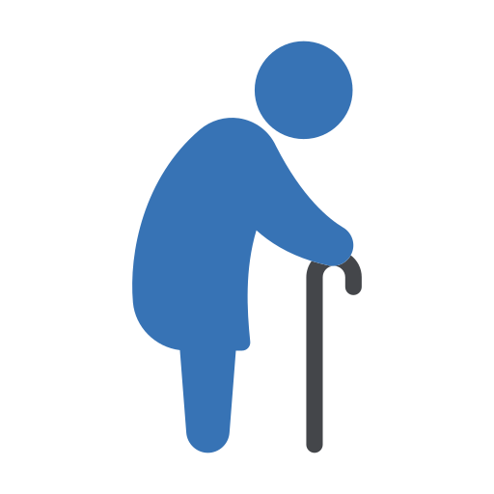
Most Affected Populations
Groups
CHILDREN
ELDERS
Rural Populations
Lower-income & Middle-income
Uninsured
Minority
Immigrants
Children from low-income families: 2x higher untreated cavity rates
Older adults face literacy and resource challenges
Rural populations lack consistent access to dentists

Slide 5
Stakeholder Insight & Need Statement
Key points from consultation:
Real patient demand for accessible self-screening tools
Similar apps used in China for progress monitoring
X-rays not feasible → focus on visual screening & education
App should avoid diagnosis; instead: screen, guide, educate
02
MIRROR
Preliminary Need Statement
There is a need for an easy-to-use, affordable platform that helps users understand and track their oral health, encouraging early intervention and regular preventive care, particularly for populations with limited access to dental services.

Slide 6
Proposed Solution

Slide 7
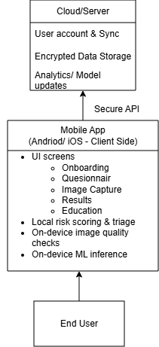
High Level Software Architecture
Figure 1. System Architecture – Client–Server View
Distributed Architecture Separation of responsibilities
Client:
Hybrid screening app (questionnaire + image QC + triage)
Server:
Secure storage
Analytics/ Model updates
User information
**Potential clinical portal integration (future goal)
All communication is encrypted (TLS 1.2+)

Slide 8
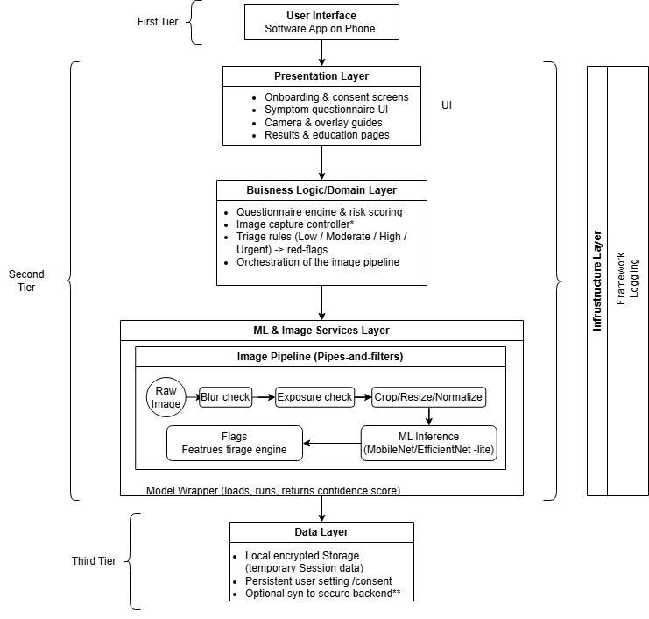
Internal Software Architecture
Layered Architecture
Separation of Concerns
Improved:
- Modularity
- Maintainability
- Scalability
Pipe and Filter
Promotes concurrency and parallel processing
Modularity
Reusability
Figure 2. System Architecture – Internal Software Architecture

Slide 9
VIDEO DEMO

Slide 10
Winter Term Development Plan
1
UI/UX Improvements
4
DATA EXPANSION & CLINICAL VALIDATION
Acquire a larger, diverse dataset of intraoral images
Collaborate with dental professionals to label oral diseases and conditions
Conduct Surveys or Interviews to get feedback on current prototype
Improved photo capture experience with potential guides
2
5
Algorithm & Model Development
Integration & Backend Development
Continue to improve prototype
Potential to develop condition specific classifier
Improve Image Quality Assessment with CNN-based sharpness/exposure classifier
Integration of Front & Backend
Privacy & Security Hardening
Monitor model & drift detection
Testing & Documentation
6
3
Performance, usability, device diversity tests etc.
Develop full SaMD Documentation
Enhanced Questionnaire & Triage System
Expand Questionnaire logic
Evidence triage updates based on clinician feedback
Provide ‘Red-flag branches’

Slide 11
Dental Infographics
1
2
Mercury is the closest planet to the Sun
Jupiter is a gas giant and the biggest planet
3
4
Saturn is the ringed one and a gas giant
Despite being red, Mars is actually cold
5
6
Neptune is the farthest planet from the Sun
Venus has a beautiful name and is the

Slide 12
Dental Infographics
 | DESCRIPTION | PRICE | REVISION
MERCURY | Mercury is the closest planet to the Sun | 105 $
VENUS | Venus has a beautiful name, but it’s terribly hot | 55 $
MARS | Despite being red, Mars is a cold place, not hot | 200 $
JUPITER | It’s the biggest planet in our Solar System | 300 $

Slide 13
Dental Infographics
MOLARS
PREMOLARS
CANINES
INCISORS
FRONT TEETH
Venus has a beautiful name but is hot place
Mercury is the
closest planet to the Sun
Despite being red, Mars is a very cold place
Jupiter is a gas giant and the biggest planet
Neptune is the farthest planet from the Sun

Slide 14
Dental Infographics
MARS
1
1
Despite being red, Mars is a cold place, not hot. It’s full of iron oxide dust
2
VENUS
2
It’s a gas giant and the biggest planet in our Solar System. Jupiter is the fourth-brightest
MERCURY
3
3
Yes, this is the ringed one. It’s a gas giant, composed mostly of hydrogen and

Slide 15
Dental Infographics
MERCURY
SATURN
Mercury is the closest planet
Yes, this is the ringed one
VENUS
JUPITER
Venus has a beautiful name
It’s a gas giant and the biggest

Slide 16
Dental Infographics
1
2
3
MERCURY
VENUS
MARS
Mercury is the closest planet
Venus has a beautiful name
Despite being red,
Mars is very cold

Slide 17
📊 SLIDE 8 — Design Problem DefinitionKey Problem:“How can we enable early, accessible, low-cost oral health screening without specialized equipment?”Parameters:Works on a smartphoneDetects visible conditionsProvides risk-based guidanceConstraints:No radiographyLimited lighting controlPrivacy and cybersecurityMust be culturally accessibleAssumptions:Users can capture 3 intraoral imagesBasic smartphone cameraLiteracy level ~grade 8🎤 Script (50 sec)“Here we outline the constraints shaping the design — technology limits, cultural expectations, and privacy needs — and the assumptions required to make the solution feasible.”

Slide 18
Dental Infographics
Mouth
cleaning
01 PROTECTION
02 BRUSHED
Jupiter is a gas giant and the biggest planet
Saturn is the ringed one and a gas giant
03 FLOSS
04 MOUTHWASH
Despite being red, Mars is actually a cold place
It’s the biggest planet in our Solar System

Slide 19
Dental Infographics
100%
60%
45%
75%
CAVITIES
GINGIVITIS
TOOTH LOSS
HALITOSIS
Jupiter is a gas giant and the biggest planet
Mercury is the closest planet to the Sun
Despite being red, Mars is actually a cold place
Saturn is the ringed one and a gas giant

Slide 20
Dental Infographics
MERCURY
VENUS
MARS
SATURN
Mercury is the closest planet to the Sun
Venus has a beautiful name and is the second
Despite being red, Mars is actually a cold place
Jupiter is a gas giant and the biggest planet

Slide 21
Dental Infographics
20%
MERCURY
Mercury is the closest planet to the Sun
AGE: 20 - 65
45%
15%
VENUS
It has a beautiful name but is hot
AGE: 6 - 20
35%

Slide 22
Dental Infographics
MARS
VENUS
SATURN
Despite being red, Mars is a cold place, It’s full of iron oxide
It’s a gas giant and the biggest planet in our Solar System
Yes, this is the ringed one. It’s a gas giant, composed of helium

Slide 23
Dental Infographics
DENTIN
ENAMEL
1
1
2
Despite being red, Mars is a cold place
Despite being red, Mars is a cold place
2
3
PULP CHAMBER
ACCESSORY CANAL
3
4
It’s a gas giant and the biggest planet
It’s a gas giant and the biggest planet
4
5
SUPPORTING LIGAMENT
ROOT-END
5
6
6
It’s a gas giant and the biggest planet
It’s a gas giant and the biggest planet

Slide 24
Dental Infographics
EXTRACTION
30%
Despite being red, Mars is a cold place, not hot. It’s full of iron oxide dust, which gives the planet its reddish cast
CLEANING
15%
It’s a gas giant and the biggest planet in our Solar System. Jupiter is the fourth-brightest object in the sky
ORTHODONTICS
55%
Yes, this is the ringed one. It’s a gas giant, composed mostly of hydrogen and helium

Slide 25
Dental Infographics
GINGIVITIS IN AMERICA
55% CANADA
25% VENEZUELA
Venus has a beautiful name and is hot
It’s the biggest planet in our Solar System
40% U.S.A
30% BRAZIL
Mercury is the closest planet to the Sun
Saturn is the ringed one and a gas giant
60% MEXICO
40% CHILE
Despite being red, Mars is actually a cold place
Neptune is the farthest planet from the Sun

Slide 26
Dental Infographics
5% ROOT CANAL
40% CLEANING
Mercury is a planet close to the sun
Jupiter is a gas giant and the biggest planet
15% EXTRACTION
40% DENTAL IMPLANT
Despite being red, Mars is a cold place
Venus has a beautiful name and is the

Slide 27
Dental Infographics
LIGHTS
DRILLS
Mercury is the closest planet to the Sun
Saturn is the ringed one and a gas giant
ODONTOLOGIC CHAIR
EXPLORATION KID
Mercury is the closest planet to the Sun
Saturn is the ringed one and a gas giant

Slide 28
Dental Infographics
95%
75%
40%
60%
REVIEW
INFECTED TOOTH
ANESTHESIA
CLEANING
It’s the biggest planet in our Solar System
It’s the biggest planet in our Solar System
It’s the biggest planet in our Solar System
It’s the biggest planet in our Solar System

Slide 29
Dental Infographics
MERCURY
VENUS
MARS
Mercury is the closest planet to the Sun and smallest one
Venus has a beautiful name and is the second planet
Despite being red, Mars is actually a cold place

Slide 30
Dental Infographics
CHECK
CLEAN
OPERATE
SMILE
Mercury is the closest planet to the Sun
Jupiter is a gas giant and the biggest planet
Despite being red, Mars is actually cold
Jupiter is a gas giant and the biggest planet

Slide 31
Dental Infographics
4
1
01 TEETH
02 DENTIST
2
It’s the second-brightest natural object in the night
sky after the Moon
It’s a gas giant and the
biggest planet in our Solar
System and the four brightest
3
03 CHAIR
04 HYGIENE
It’s a gas giant and the
biggest planet in our Solar
System. And the biggest
Yes, this is the ringed one.
It’s a gas giant, composed
mostly of hydrogen

Slide 32
Dental Infographics
1
CAVIETIS
Mercury is the closest planet to the Sun and the smallest one
1
2
GINGIVITIS
Despite being red, Mars is a cold place, not hot. It’s full of iron
2
3
PERIODONTITIS
Yes, this is the ringed one. It’s a gas giant, composed of hydrogen
3

Slide 33
Dental Infographics
25%
40%
35%
CAVITIES
ORTHODONTICS
DENTAL HEALTH
Despite being red, Mars is actually a cold place
Jupiter is a gas giant and the biggest planet
Mercury is the closest planet to the Sun

Slide 34
Dental Infographics
1 TOOTH
2 DRILL
3 DENTIST
4 CAVITIES
It’s a gas giant and the
biggest planet in our Solar
System. And the biggest
It’s the second-brightest natural object in the night
sky after the Moon
Yes, this is the ringed one.
It’s a gas giant, composed
mostly of hydrogen
Saturn is the ringed one and a gas giant System. And the biggest one
3
2
4
1

Slide 35
Instructions for use (free users)
In order to use this template, you must credit Slidesgo by keeping the Thanks slide.
You are allowed to:
Modify this template.
Use it for both personal and commercial purposes.
You are not allowed to:
Sublicense, sell or rent any of Slidesgo Content (or a modified version of Slidesgo Content).
Distribute this Slidesgo Template (or a modified version of this Slidesgo Template) or include it in a database or in any other product or service that offers downloadable images, icons or presentations that may be subject to distribution or resale.
Use any of the elements that are part of this Slidesgo Template in an isolated and separated way from this Template.
Delete the “Thanks” or “Credits” slide.
Register any of the elements that are part of this template as a trademark or logo, or register it as a work in an intellectual property registry or similar.
For more information about editing slides, please read our FAQs or visit Slidesgo School:
https://slidesgo.com/faqs and https://slidesgo.com/slidesgo-school

Slide 36
Instructions for use (premium users)
In order to use this template, you must be a Premium user on Slidesgo.
You are allowed to:
Modify this template.
Use it for both personal and commercial purposes.
Hide or delete the “Thanks” slide and the mention to Slidesgo in the credits.
Share this template in an editable format with people who are not part of your team.
You are not allowed to:
Sublicense, sell or rent this Slidesgo Template (or a modified version of this Slidesgo Template).
Distribute this Slidesgo Template (or a modified version of this Slidesgo Template) or include it in a database or in any other product or service that offers downloadable images, icons or presentations that may be subject to distribution or resale.
Use any of the elements that are part of this Slidesgo Template in an isolated and separated way from this Template.
Register any of the elements that are part of this template as a trademark or logo, or register it as a work in an intellectual property registry or similar.
For more information about editing slides, please read our FAQs or visit Slidesgo School:
https://slidesgo.com/faqs and https://slidesgo.com/slidesgo-school

Slide 37
Infographics
You can add and edit some infographics to your presentation to present your data in a visual way.
Choose your favourite infographic and insert it in your presentation using Ctrl C + Ctrl V or Cmd C + Cmd V in Mac.
Select one of the parts and ungroup it by right-clicking and choosing “Ungroup”.
Change the color by clicking on the paint bucket.
Then resize the element by clicking and dragging one of the square-shaped points of its bounding box (the cursor should look like a double-headed arrow). Remember to hold Shift while dragging to keep the proportions.
Group the elements again by selecting them, right-clicking and choosing “Group”.
Repeat the steps above with the other parts and when you’re done editing, copy the end result and paste it into your presentation.
Remember to choose the “Keep source formatting” option so that it keeps the design. For more info, please visit Slidesgo School.

